Slide 1
GYM MANAGEMENT SYSTEM

Slide 2
INTRODUCTION
The Gym Management System is a C++ console application built using OOP principles.
What the system does:
Automates member registration and payment validation
Enables fast member searching and deletion
Stores and manages gym records securely across sessions

Slide 3
A. SYSTEM ARCHITECTURE
System architecture describes the high-level structure of the entire system and shows how major components interact. The Gym Management System adopts a centralized software architecture consisting of user authentication, member management, payment processing, data storage, and recovery modules.

Slide 4
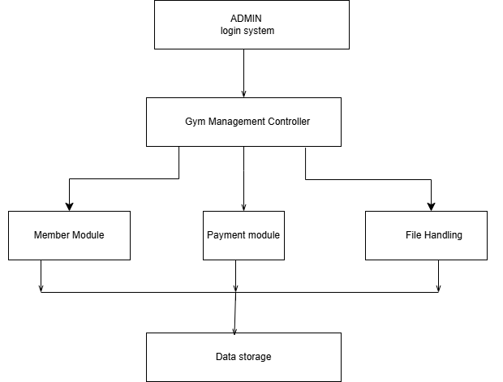

Slide 5
Explanation of Major Components
1. Admin Login Module
The Admin Login module controls access to the system by verifying the username and password entered by the administrator.
Function
Authenticates users before granting access
Prevents unauthorized access
Secures gym records and operations
Why Required
The login system ensures that only authorized personnel can manage gym records and perform administrative operations.
Components Used
Username
Password
Boolean validation logic

Slide 6
Member Management Module
The Member Management module is responsible for handling all member-related operations within the system.
Function
Register new gym members
Store member details
Display member records
Search member information
Delete members
Restore deleted members
Data Managed
Member ID
Member name
Contact number
Membership package
Gym timing
Payment information
Why Required
This module forms the core functionality of the system by organizing and maintaining gym member information efficiently

Slide 7
Payment Processing Module
. The Payment module validates and processes membership payments.
Function
Accept payment amount
Compare payment against membership fee
Approve or reject registration
Payment Logic
Gold Package = KES 2500
Silver Package = KES 2000
If payment is less than the required amount:
Registration fails
Member is not stored
Why Required
This module ensures that only fully paid members are registered into the system

Slide 8
4. File Handling Module
The File Handling module manages permanent storage of member records.
Function
Save data into files
Load saved records
Preserve records after program termination
File Used
gym_members.txt
Why Required
Without file handling, all data would be lost once the program closes. This module ensures permanent data storage.

Slide 9
5. Undo Delete Module
The Undo Delete module restores recently deleted members using a stack data structure.
Function
Store deleted members temporarily
Recover accidentally deleted records
Data Structure Used
stack<Member>
Why Required
This feature improves system reliability and prevents permanent accidental deletion of records.

Slide 10
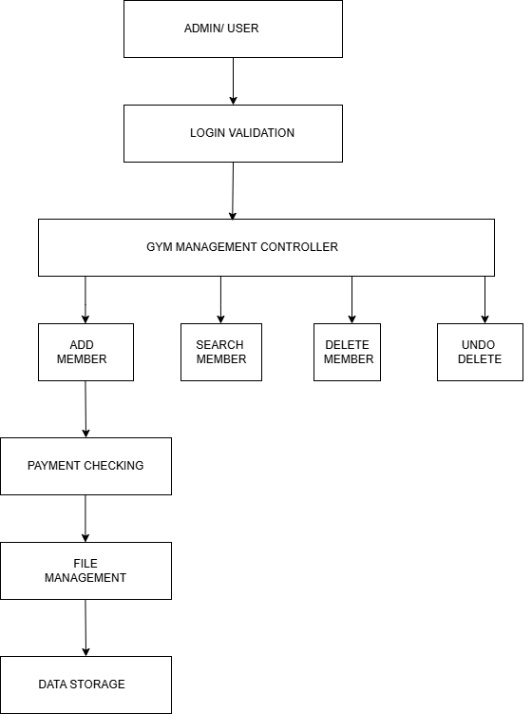
B. SYSTEM BLOCK DIAGRAM

Slide 11
1. Login Validation Block
Function
This block verifies the administrator username and password before allowing access to the system.
Inputs
Username
Password
Outputs
Login successful
Access denied
Why Required
It secures the system and prevents unauthorized users from accessing sensitive records.

Slide 12
2. Add Member Block
Function
This block registers new gym members into the system.
Activities Performed
Collect member details
Select membership package
Choose gym timing
Process payment
Save records
Why Required
It automates member registration and reduces manual record management.

Slide 13
3. Payment Checking Block
Function
This block validates whether the member has paid the required fee.
Conditions
Gold membership requires KES 2500
Silver membership requires KES 2000
Decision Logic
If payment ≥ fee → Registration approved
If payment < fee → Registration rejected
Why Required
It ensures accurate payment verification before storing records.

Slide 14
4. Search Member Block
Function
This block searches for a member using the member ID.
Purpose
Quickly retrieve records
Improve accessibility of information
Why Required
Searching improves efficiency in locating specific member records.
5. Delete Member Block
Function
This block removes members from the system database.
Activities
Identify member using ID
Remove member from vector
Save updated records
Why Required
Allows administrators to remove inactive or terminated members.

Slide 15
6. Undo Delete Block
Function
Restores the most recently deleted member.
Data Structure Used
stack<Member>
Why Required
Provides recovery functionality in case of accidental deletion.
7. File Management Block
Function
Handles permanent storage of records.
Operations
Save member records
Load saved records
Update stored information
Why Required
Ensures data persistence and long-term storage

Slide 16
C. DATA
This section describes the types of data used in the Gym Management System and explains how the data is received, processed, stored, and displayed by different system modules.
1. Member Data (Input Data)
Member data refers to information entered during registration.
Type
Text and numerical data.
Examples
Member ID
Member name
Contact number

Slide 17
2. Membership Package Data
This data defines the category of membership selected by the member.
Types
Gold Package
Silver Package
Associated Fees
Gold = KES 2500
Silver = KES 2000

Slide 18
3. Payment Data
Payment data represents the amount paid by the member.
Type
Numerical values.
Examples
KES 2500
KES 2000
Purpose
To validate registration eligibility.

Slide 19
4. Timing Data
This data stores the selected gym training session.
Examples
6AM – 7AM
7AM – 8AM
5PM – 6PM
Purpose
To organize gym schedules and avoid overcrowding
5. Processed Data
Generated after the system validates user input and payment conditions.
Examples
“Payment Successful”
“Registration Failed”
“Member Found”
Purpose
To provide feedback and support decision-making.

Slide 20
6. Control and Decision Data
Generated by the Gym Management Controller.
Type
Logical decisions and conditions.
Examples
Approve registration
Reject registration
Restore deleted member
Purpose
To automate gym operations and reduce manual errors.
7. File Storage Data
This data is permanently stored in:
gym_members.txt
Information Stored
Member details
Membership type
Payment records
Timing information
Purpose
To preserve records after the system closes

Slide 21
8. Recovery Data
This data stores deleted members temporarily.
Data Structure Used
stack<Member>
Purpose
Supports undo delete functionality
9. Security Data
Used for authentication and system protection.
Examples
Admin username
Admin password
Purpose
To prevent unauthorized access to gym records.

Slide 22
CONCLUSION
The Gym Management System successfully demonstrates the implementation of Object-Oriented Programming principles in C++. The system automates gym operations including member registration, payment validation, searching, deletion, and permanent record storage.
The project improves:
Efficiency
Data organization
Security
Accuracy

Slide 23
The system also demonstrates practical application of:
Encapsulation
Inheritance
Polymorphism
Abstraction
File handling
Vectors
Stacks

